Slide 1
Security & File Permission

Slide 2
File System Security
Concerned with preventing unauthorized access to the system’s data.
Access of data is controlled through the use of file permissions.
File permissions are used to control what operations may be performed on a directory/file and by whom they may be performed

Slide 3
Types of Users
user(owner): he is the user who create the file.
group: They are the users who belong to the same group that the owner of the file belongs.
others : they are any other users in the system.
And there is a super user (the root) is the administrator of the computer system which have access privileges to all files.

Slide 4
Why should you learn about permissions?
May allow others to access, alter and even delete your files!
The default setting is not acceptable where sensitive data is present.
Many beginning users of Unix don’t understand modes, thus compromising overall security.
Permissions are a useful tool to enhance file system security!

Slide 5
Permission Codes
determine who can access and manipulate a directory or file
permission codes are divided in to three set of codes
first set contains the permission of the owner
second set contains group permissions
third set contains permissions for others
code for each set is a triplet read (r), write(w), execute(x)

Slide 6
3 Levels of Access Protection
r | read | read a file | read contents of directory
w | write | write data to a file | change the contents of the directory
x | execute | run an executable program | search the contents of a folder or subdirectory

Slide 7
Format of Permissions
_ _ _ _ _ _ _ _ _ _
file or
directory?
User
modes
Group
modes
Other
modes

Slide 8
Determining and changing file access privileges
ls -l[file-list]
ls -ld [directory-list]
The above command will display long list of files/directories on the console which has info about the file access privileges and other info.
$ls -l
-rwx r-x--- 1 ymk faculty 512 mar 23 07:23 course
course has the following permission
  user read, write, and execute
  group read and execute
  others denied.

Slide 9
Setting Permissions
The chmod command is used to set or modify file and directory permissions
2 ways to specify permissions:
- symbolic mode
- octal mode
Notes:
To turn on permissions

Slide 10
Setting Permissions :
Symbolic Mode
chmod <who> op <perm bits> <filename>
 | options
who | u, g, o, a
op | +, -, =
perm bits | r, w, x

Slide 11
Adding Permissions - Example
ls -l file1
-rw- r-- r-- … (current permissions)
chmod g+w file1
ls -l file1
-rw- rw- r-- (updated permissions)
Notes:
– allows user group to write to the file(in addition to any other previously, allocated permissions for that file)
OR chmod 1755 <filename>

Slide 12
Subtracting Permissions
>ls -l file1
-rw- rw- r-- (current permissions)
>chmod g-w file1
>ls -l file1
-rw- r-- r-- (updated permissions)
Notes:
Back to where we started

Slide 13
octal Mode – Example
To let the owner read, write, and execute:
400 + 200 + 100 = 700
Yet, only allow group users and others to read and write to the file:
040 + 020 +000 = 060 (group value)
004 + 002 +000 = 006 (others value)
The octal value = 700 + 060 + 006
> chmod 766 filename

Slide 14
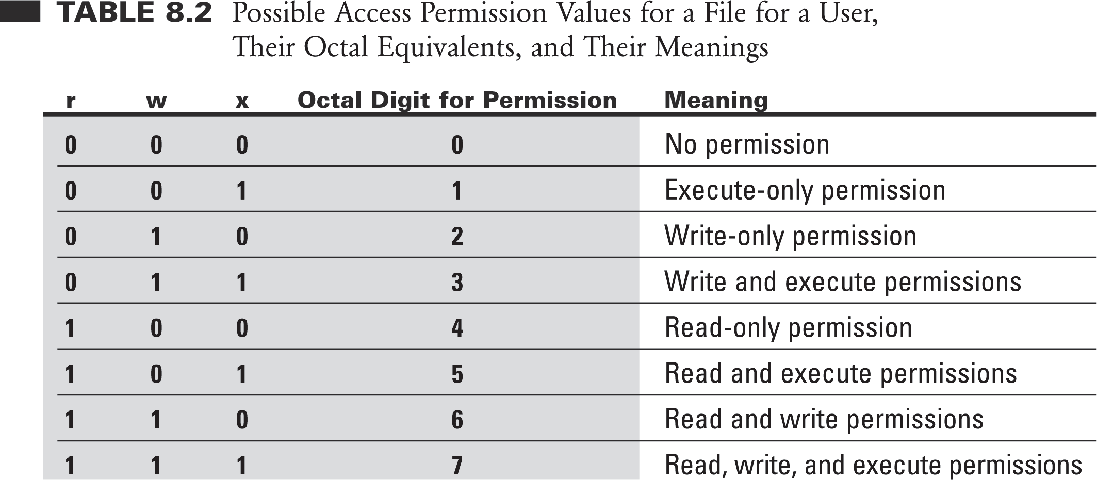
Access Types (cont…)

Slide 15
chown
To change the owner of a file/directory ,use the chown command
chown [
SYNTAX
OPTIONS] newowner : group file/dir
when the recursive option -r is used with in a directory, all files in the directory and all other subdirectories and their files are changed recursively

Slide 16
chgrp
To change the group without changing the owner of a file/directory, use the chgrp command
SYNTAX
chgrp [OPTIONS] newgroup file/dir
-r option recursively change the group of an entire directory

